Slide 1
IT4 CALCULUS 1 LESSON 5

Slide 2
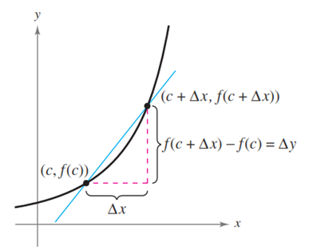




CALCULUS THE SLOPE

Slide 3







CALCULUS THE SLOPE - EXAMPLE

Slide 4




CALCULUS THE SLOPE - EXERCISE

